Slide 1
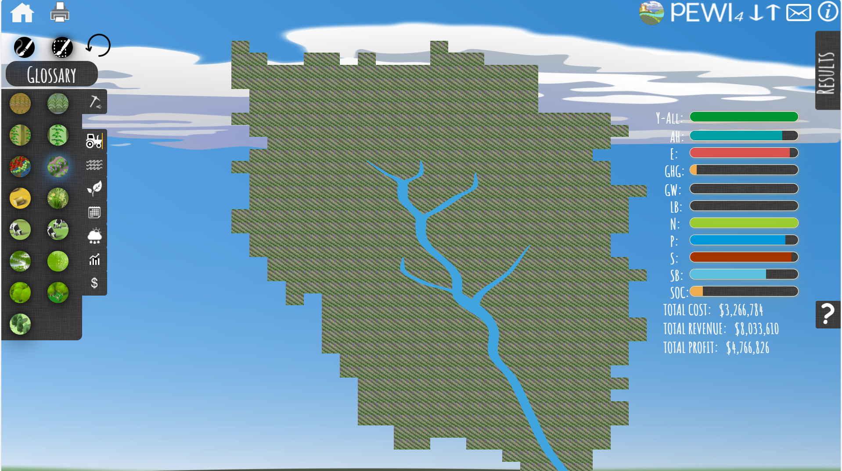
Alfalfa
Total yield: 31753.4 tons
Unit price: 253/ton
Unit cost: 554.75/acre

Slide 2
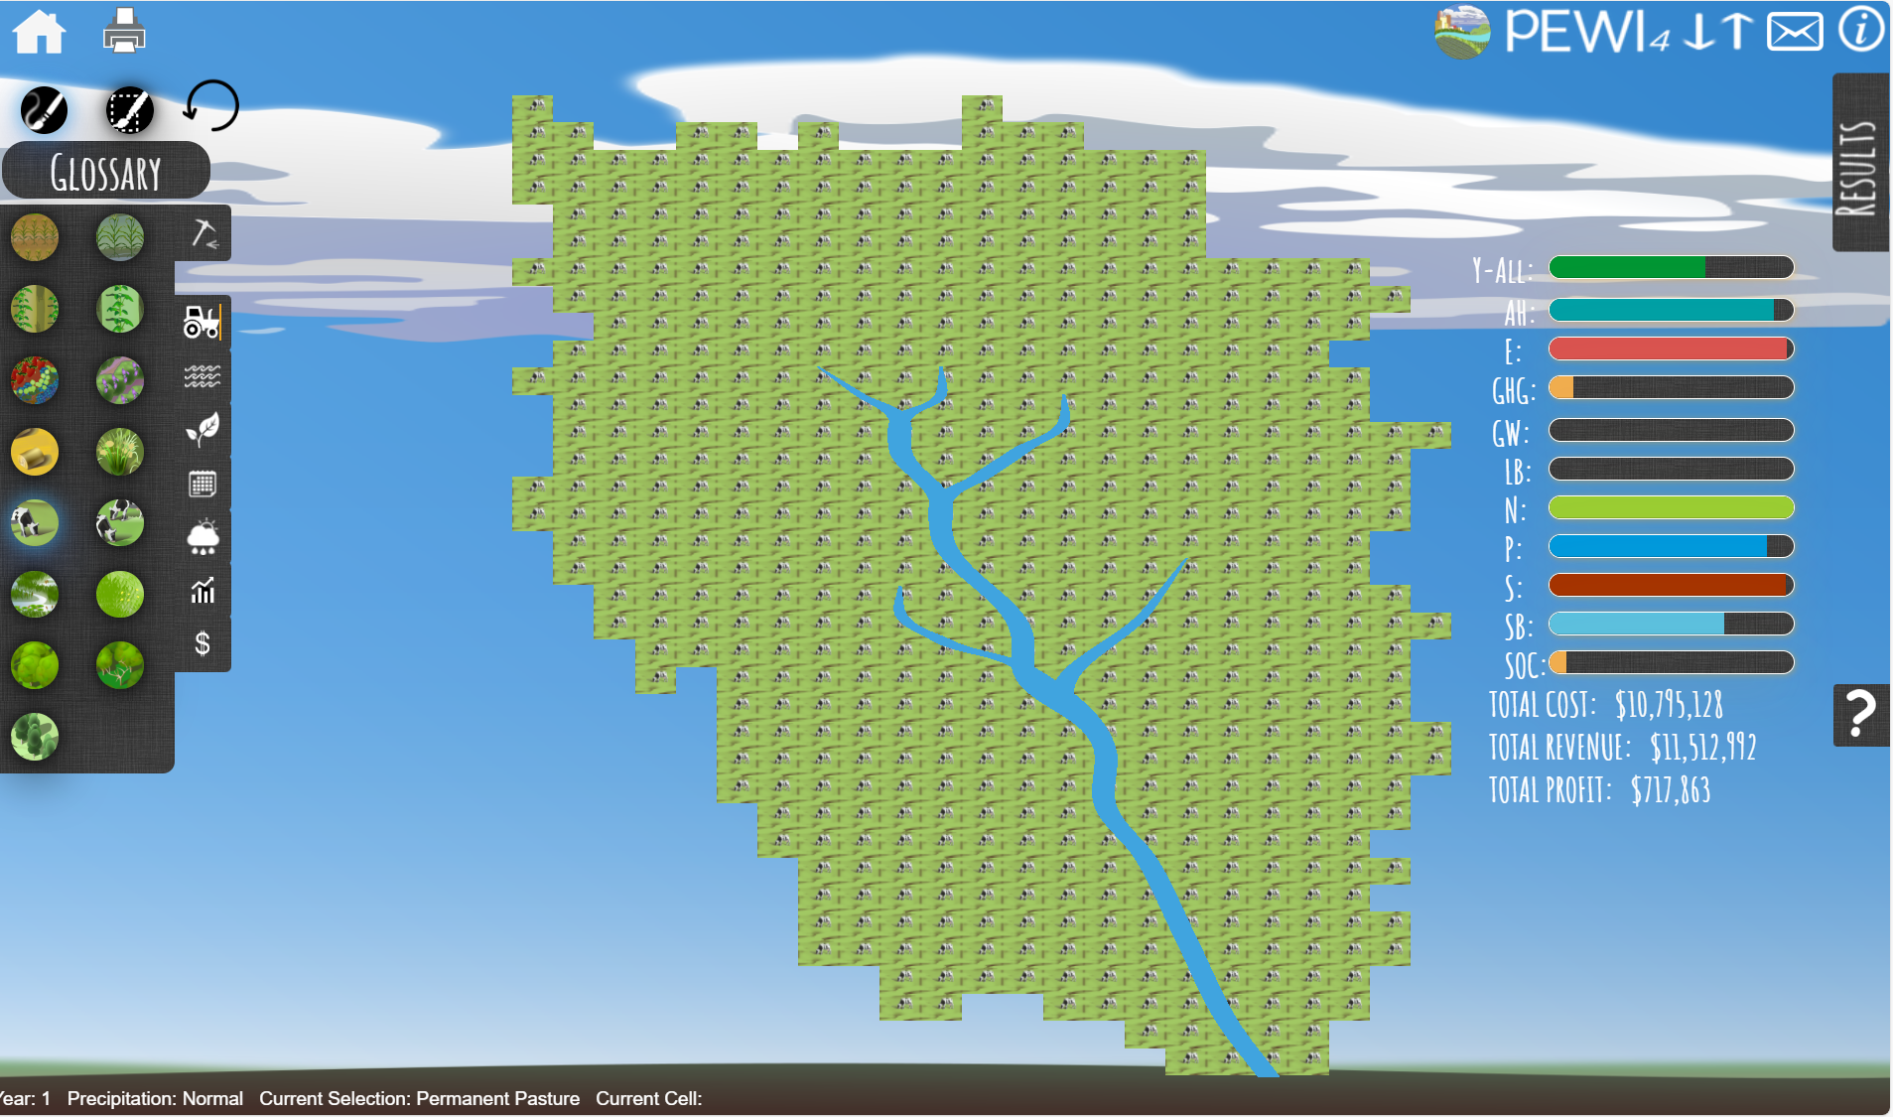
Permanent Pasture
Total yield: 3,087.1 animals
Unit price: 3496.81/animal
Unit cost: 3729/animal

Slide 3
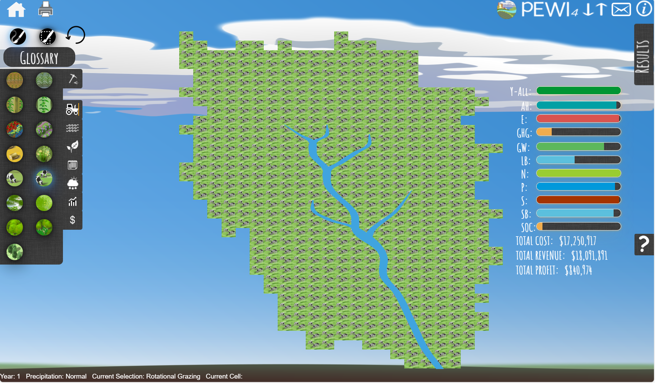
Rotational Grazing
Total yield: 4851.2 animals
Unit price: 3556/animal
Unit cost: 3729/animal

Slide 4
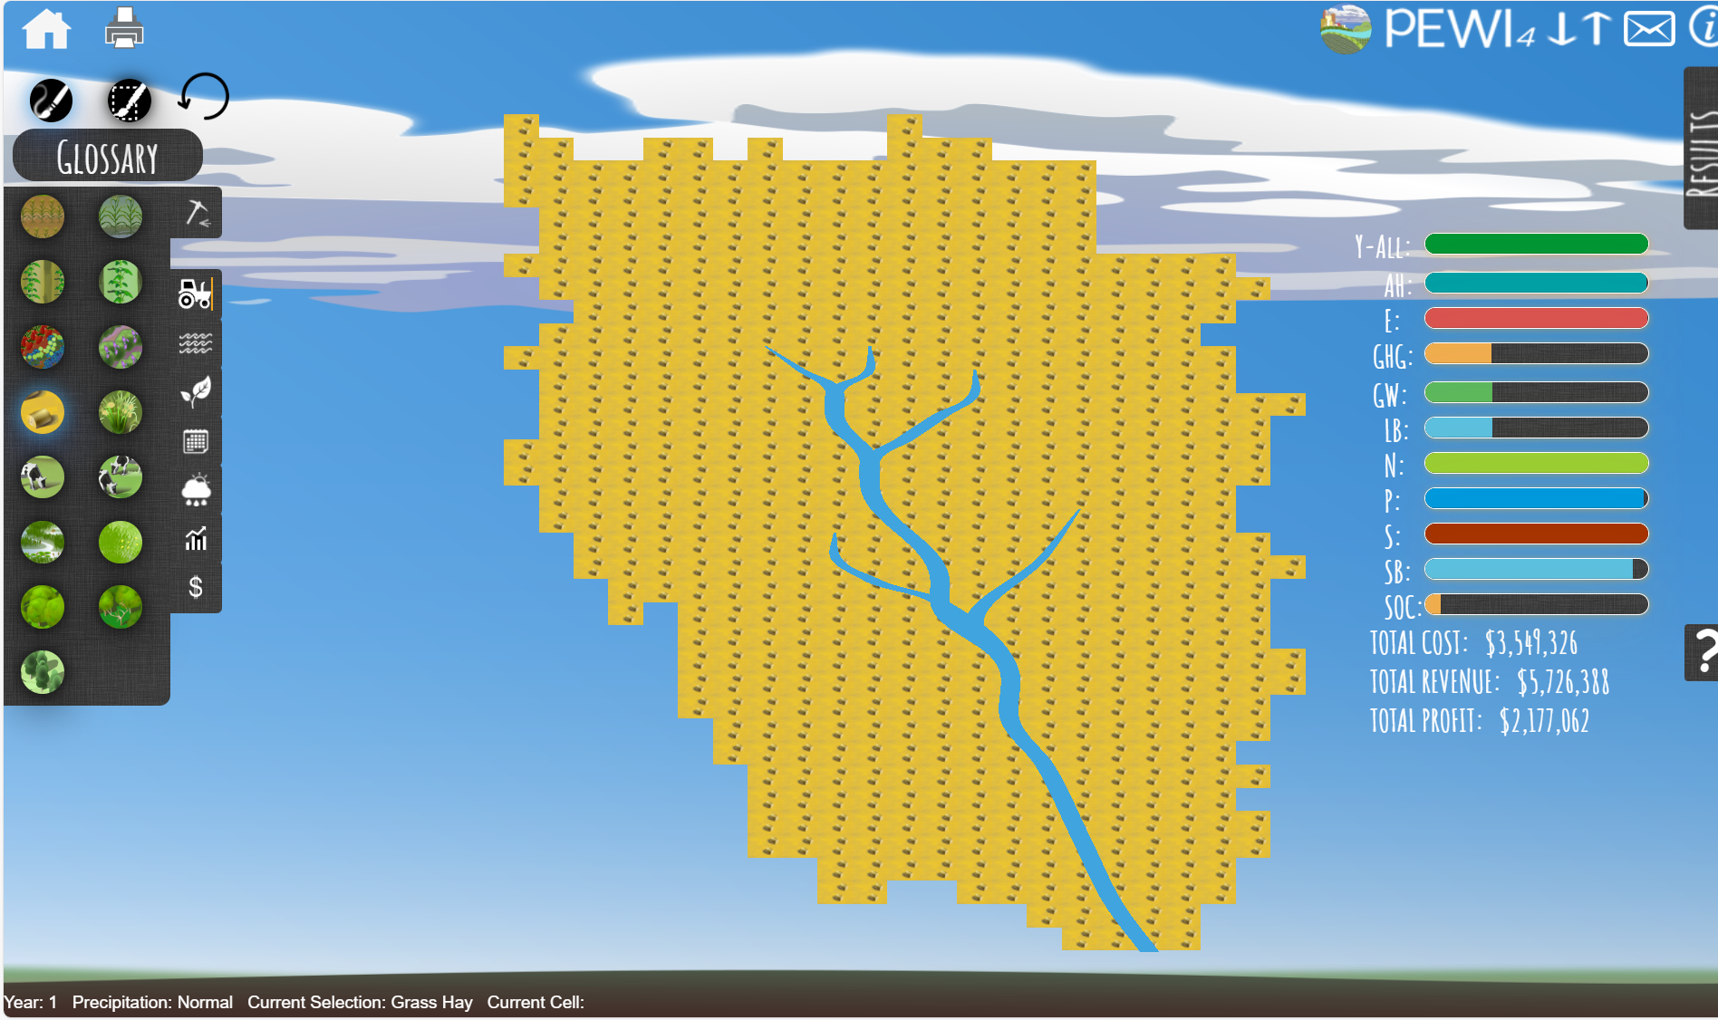
Grass hay
Total yield: 31,753.4 tons
Unit price: 253/tons
Unit cost: 602.73/acre

Slide 5
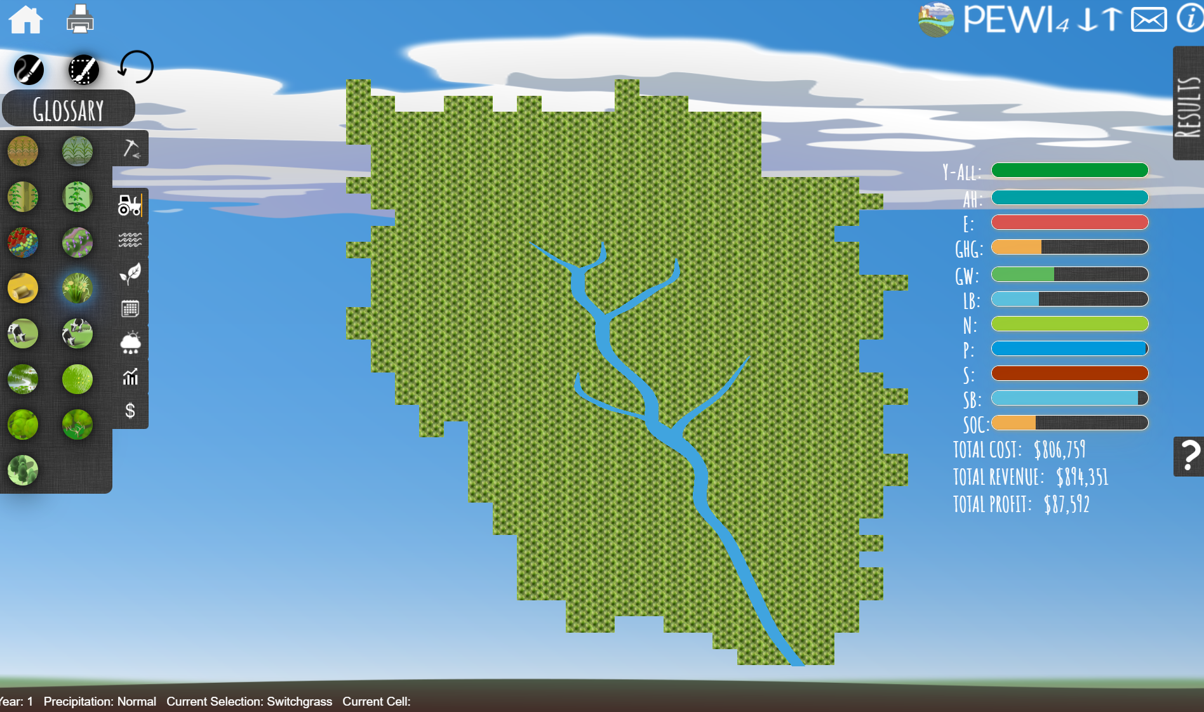
Switchgrass
Total yield: 14,637.8 tons
Unit price: 60/tons
Unit cost: 137/acre

Slide 6
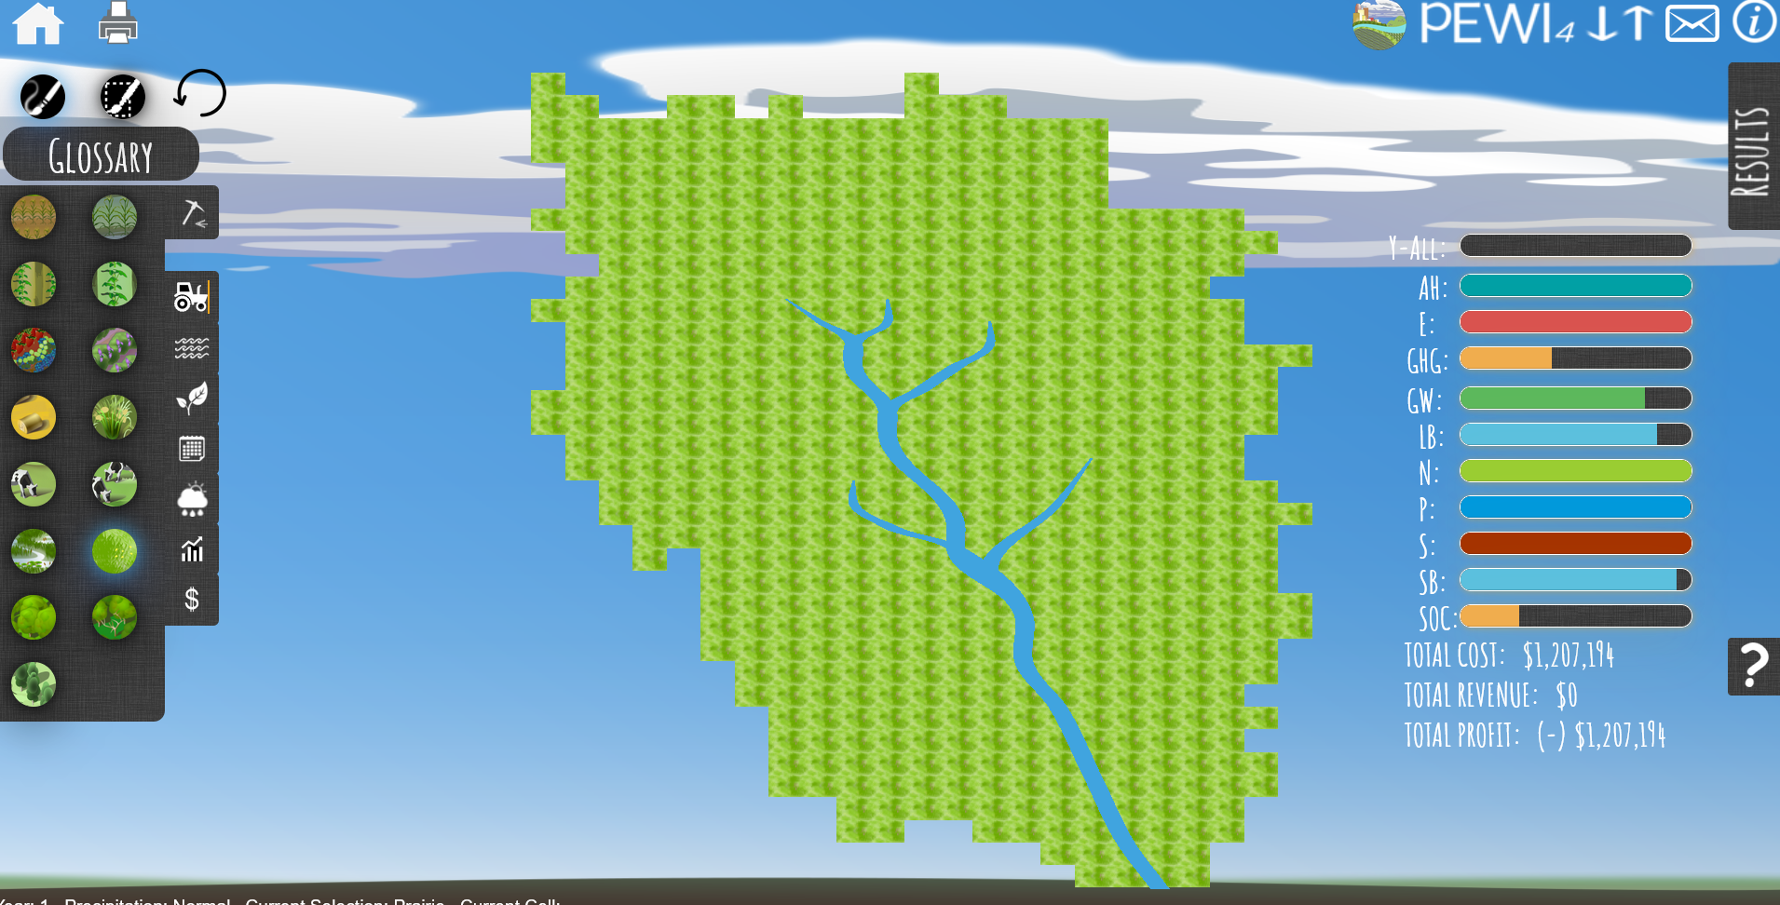
Prairie
Total yield: 0 tons
Unit price: 0/acre
Unit cost: 205/acre

Slide 7
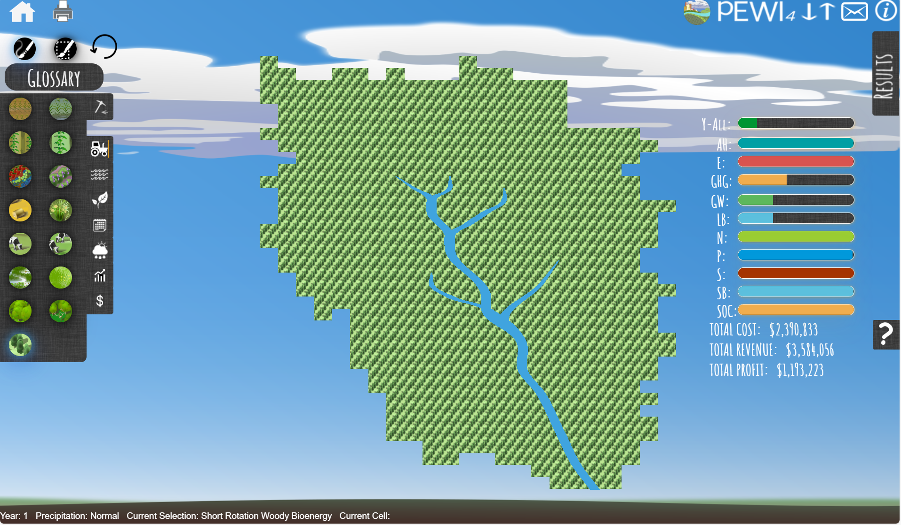
Short Rotation Woody Bioenergy
Total yield: 58,843.0 tons
Unit price: 60/ton
Unit cost: 406/acre

Slide 8
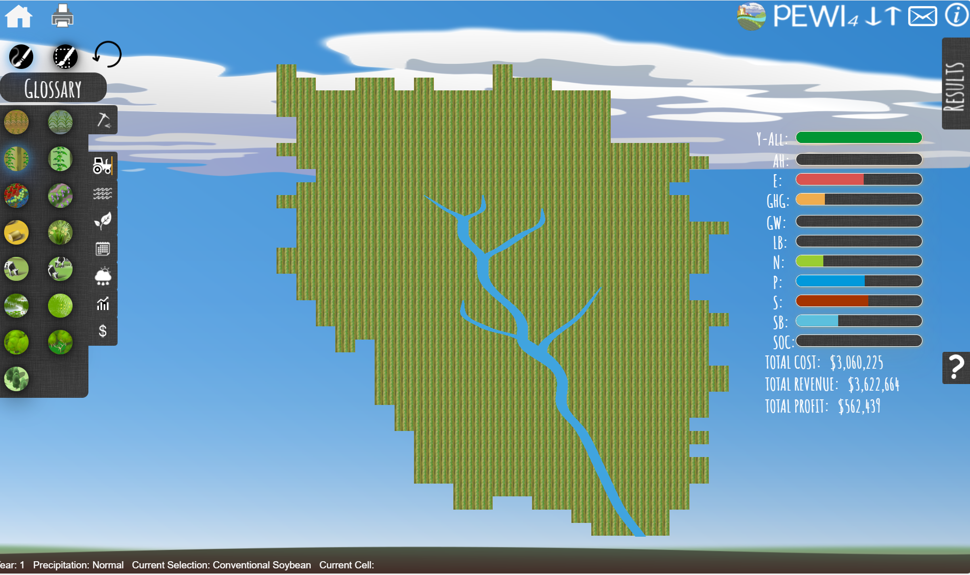
Conventional Soybean
Total yield: 349,341.0 bushels
Unit price: 10.37/bushel
Unit cost: 8.76/bushel

Slide 9
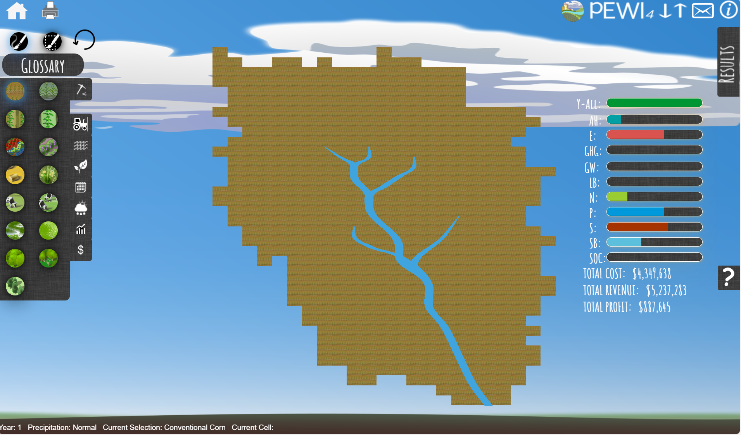
Conventional Corn
Total yield: 1,203,973.0 bushels
Unit price: 4.35/bushel
Unit cost: 3.87/bushel

Slide 10
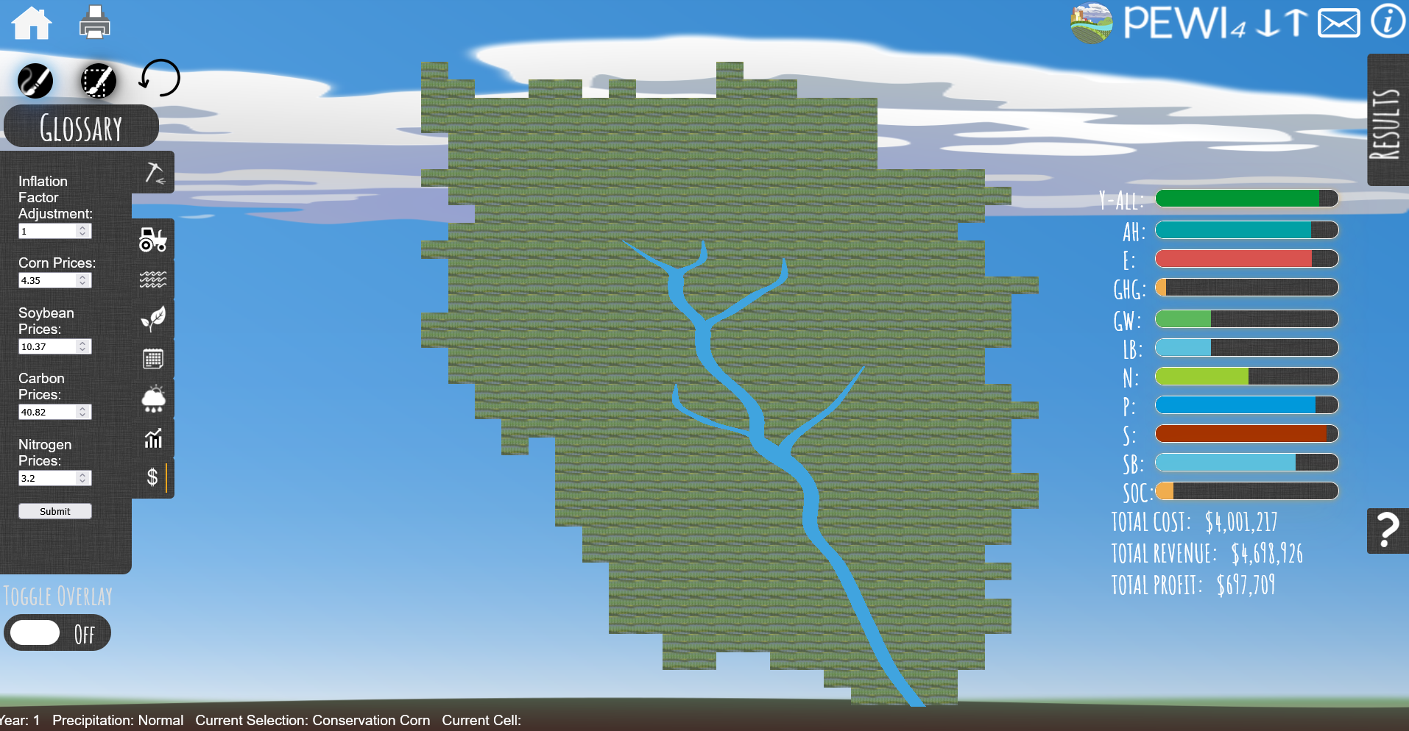
Conservation Corn
Total yield: 1,080,213.0 bushels
Unit price: 4.35/bushel
Unit cost: 3.56/bushel

Slide 11
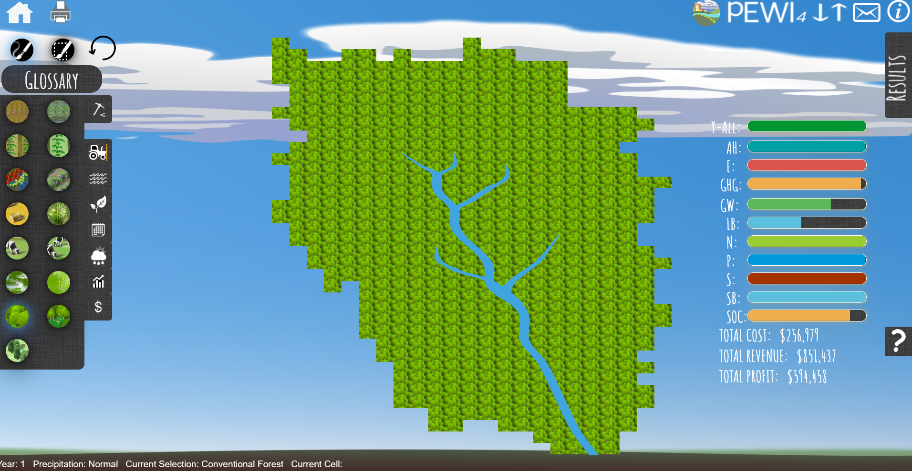
Conventional Forest
Total yield: 1,077,768.8 board ft
Unit price: 0.79/board ft
Unit cost: 43.63/board ft

Slide 12
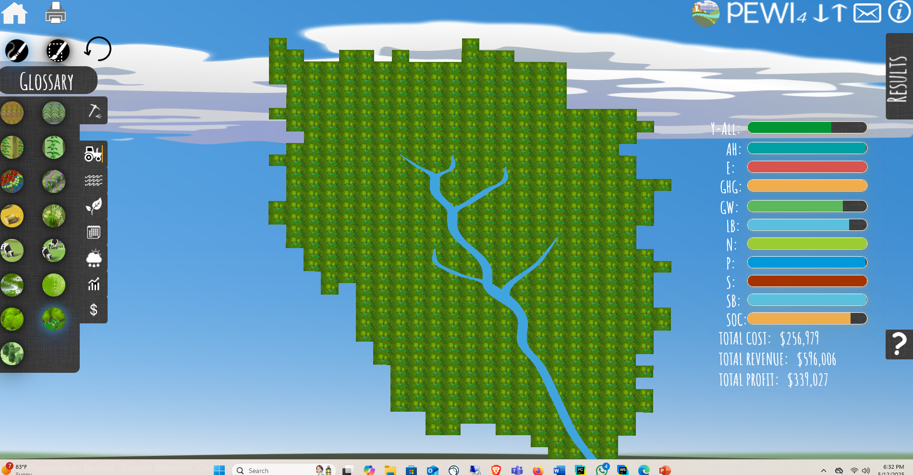
Conservation Forest
Total yield: 1,077,768.8 board ft
Unit price: 0.79/board ft
Unit cost: 43.63/board ft

